Slide 1
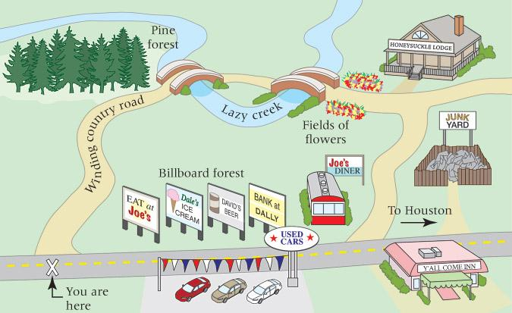
4.4.4 Classification of algorithms
Syllabus Details
4.4.4 Classification of algorithms
4.4.4.1 Comparing algorithms
4.4.4.2 Maths for understanding Big-0 notation
4.4.4.3 Order of complexity
4.4.4.1 Comparing algorithms
Starter
On the next page write down two different directions to Joe’s Diner from the You are here cross.

Slide 2
Starter
Which one is the most efficient set of instructions? Are there different methods of stating efficiency?

Slide 3
Key term
Basic operations
THe operation contributing the most to the total running time of the algorithm.
Resources consumed
Time
The computation times of different algorithms depends on the hardware of the coputer as well as the optimisation of the algorumt
The time to compute can also changed depending on the size of the input as well as the amount of memory consumed

Slide 4
Size of problem
Algorithms normally accept an input and perform a process on them. This means the number of operations is tied to the size of the input. This is known as the size of the problem
Key term
Order of magnitude of a function or order of function
Identifies with the term in the function that increases fastest relative to the size of the problem.
Key Point
Asymptotic behaviour
By considering the asymptotic behaviour of an algorithm rather than its actual output, it is possible to ignore/hide factors and constants that change with the speed of the processor, the arrangement of data in memory, and other specifics such as whether the program is interpreted or compiled, whether one programming language generates more instructions for the same task than another.
Question
List the following functions from lowest to highest order. If any are of the same order, place them next to each other in the list and circle them.
N + 5N² + 2N³ N³ N² N⁴ - 4 N² + 6N N

Slide 5
Growth Rate
Size of the input data N | f(N) =N | f(N) = N² | f(N) = 2^{N}
1
10
100
1000
10000
Asymptotic function | f(N) =N | f(N) = N² | f(N) = 2^{N}
Growth rate | Liniar | Quadratic | Exponential
Description | The amount of work is direclty proportianl to the input | A nested for loop | The sizie increases dramaticly in relation to the problem
Key term
Complexity class of an algorithm
Algorithms are classified by their growth rates into complexity classes.
The growth rate of an algorithm is given by the order of the asymptotic function f(N) for the worst-case.

Slide 6
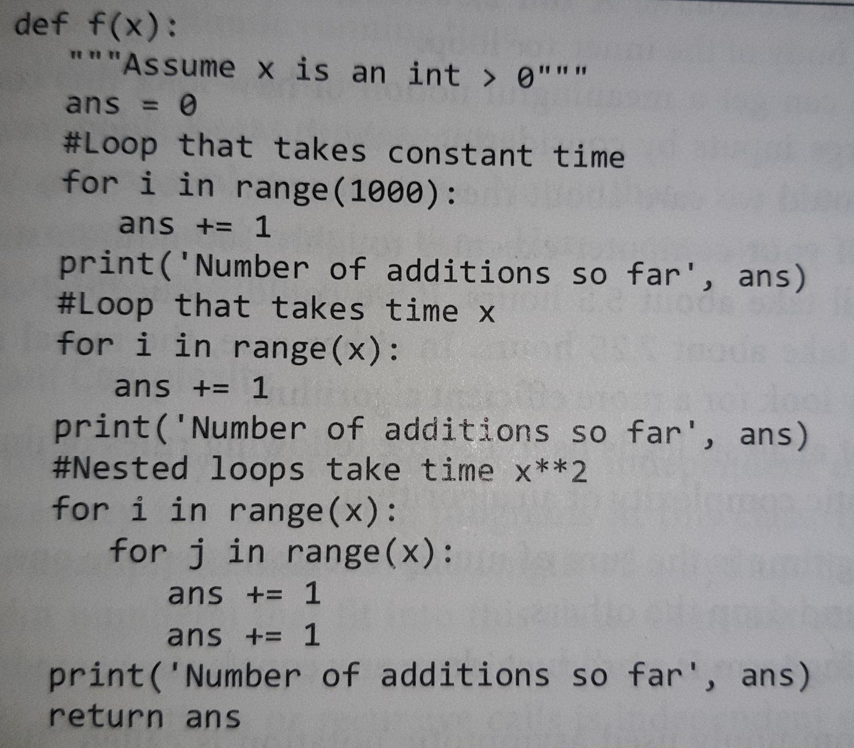
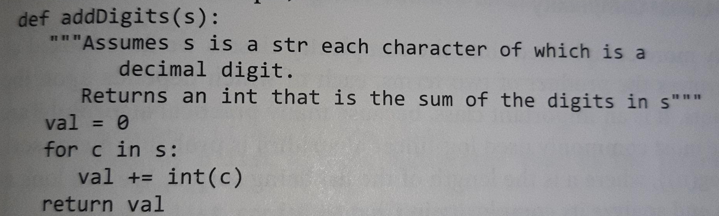
Work out the polynomial for each algorithm
1000+x+2x^2
As x -> inf
X^2
s

Slide 7
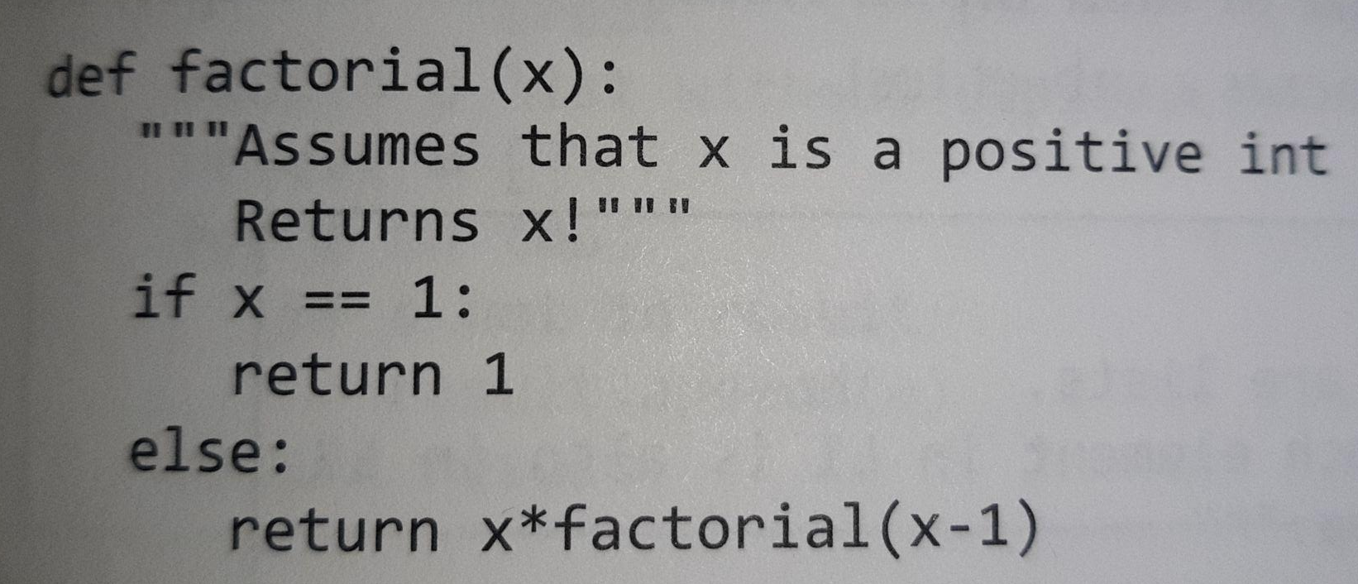
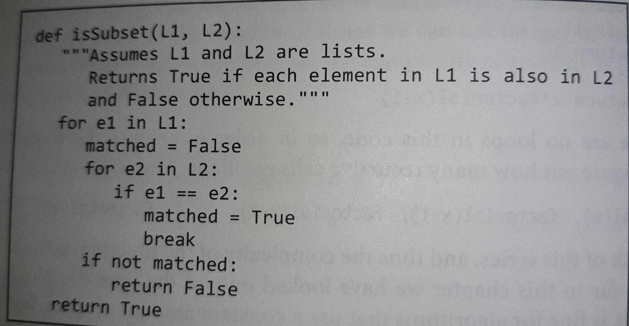
Work out the polynomial for each algorithm
x
L1*L2

Slide 8
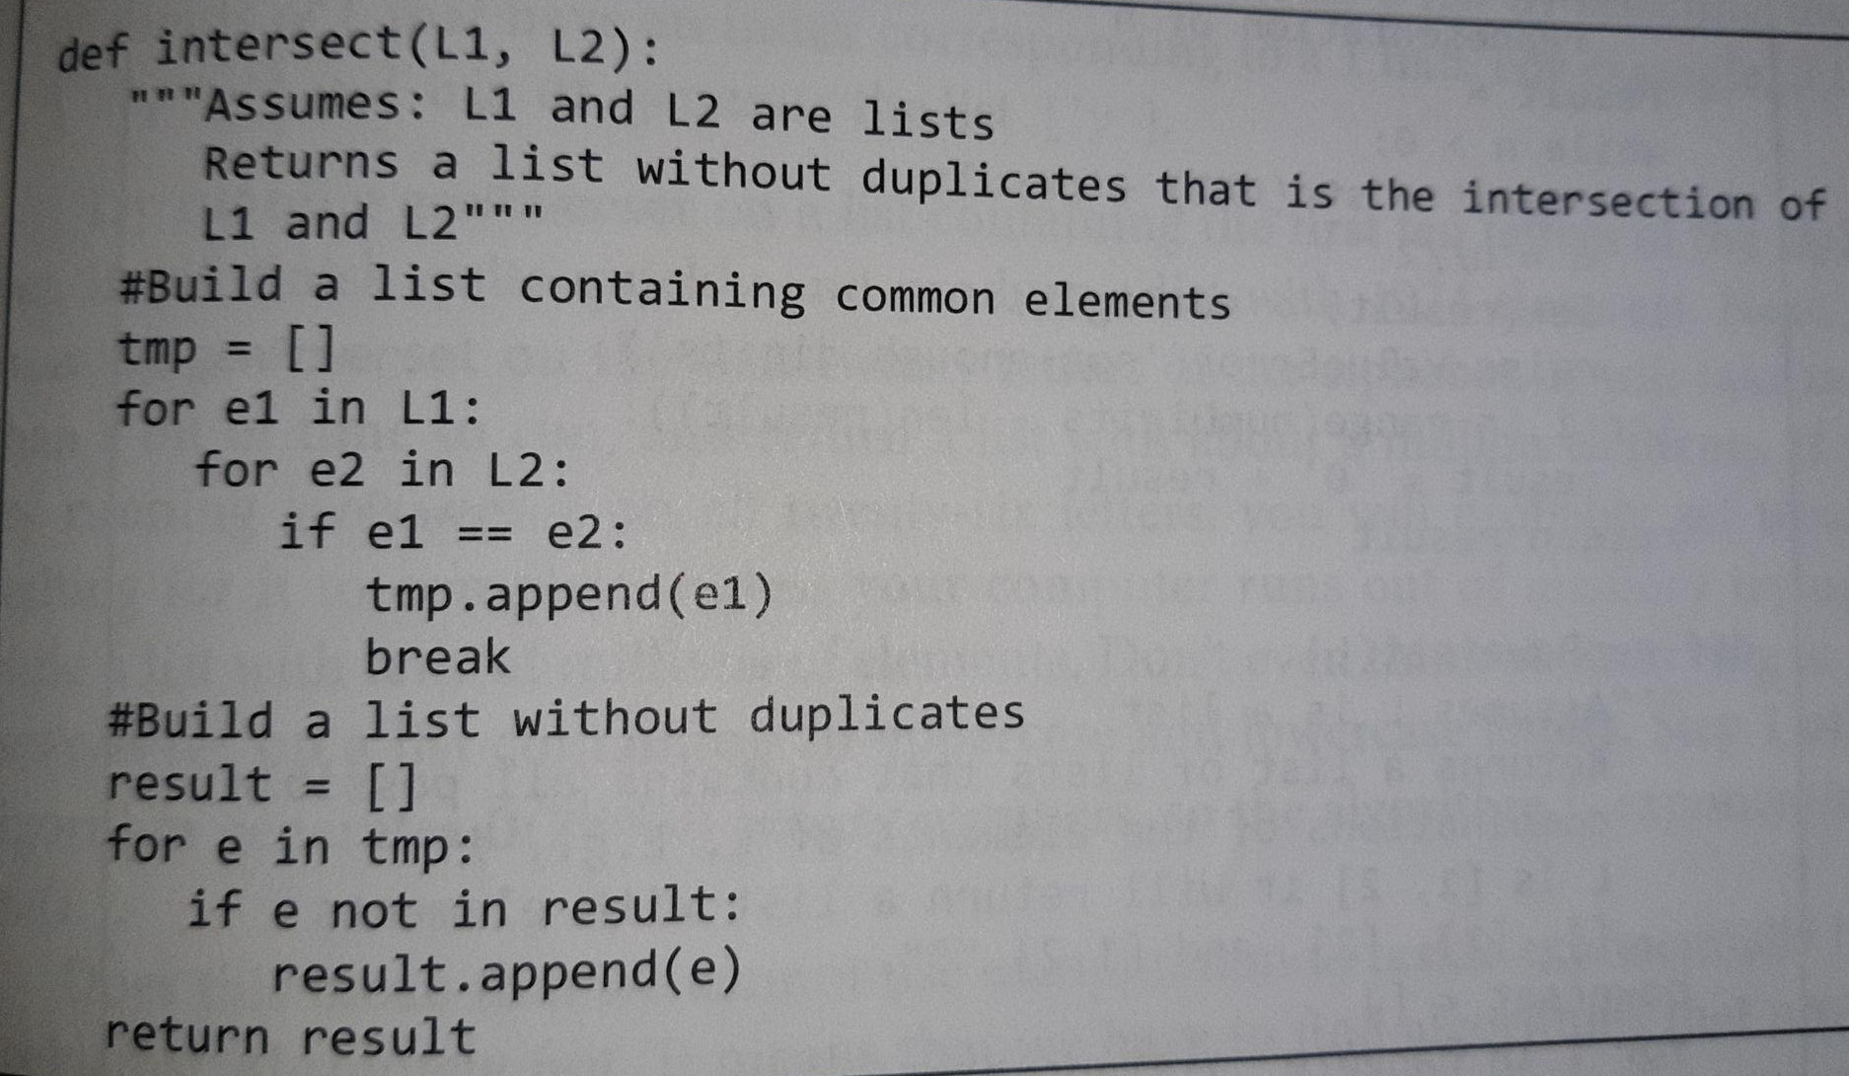
Work out the polynomial for each algorithm

Slide 9
Complexity of a problem
Time complexity
Space complexity
The mesure of the amount of working storeage required for an algorythm
It is the worst case senario
Support
PGonline - Section 8 p 229
LMC - Paper 1 theory p227
Hacker Rank Colt Steele
Video 1 Video 2

Slide 10
Trade off between time-complexity and space- complexity
Finding factors of an integer N | Finding the least factor of N
FindFactors(N) While N > 1 Factor = LeastFactor(N) Output Factor N = N Div Factor EndWhile | LeastFactor(N) i = 1 Repeat i = i + 1 Until (N Mod i) = 0 Return i

Slide 11
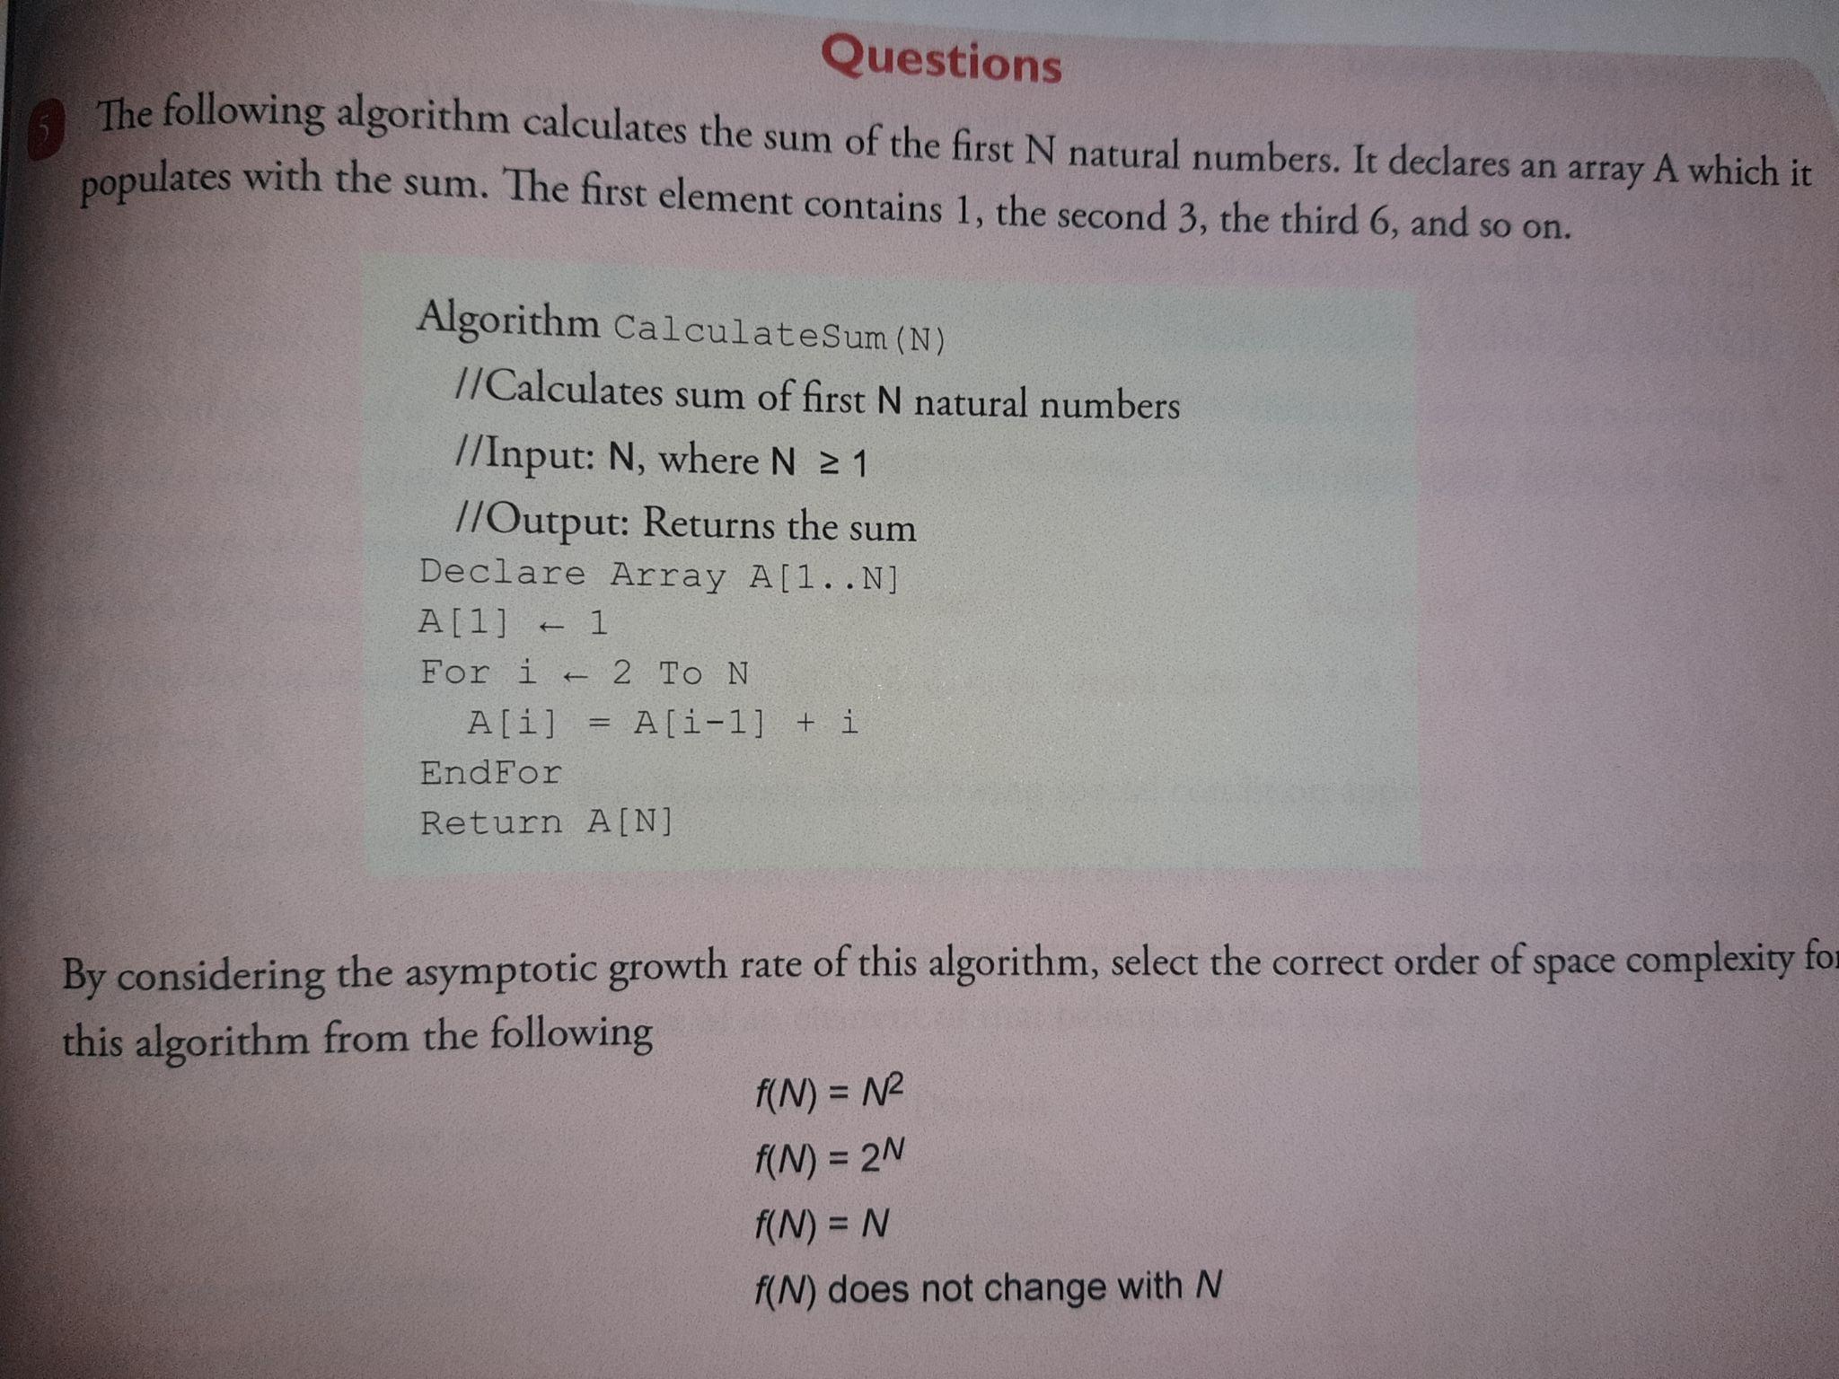
Questions

Slide 12
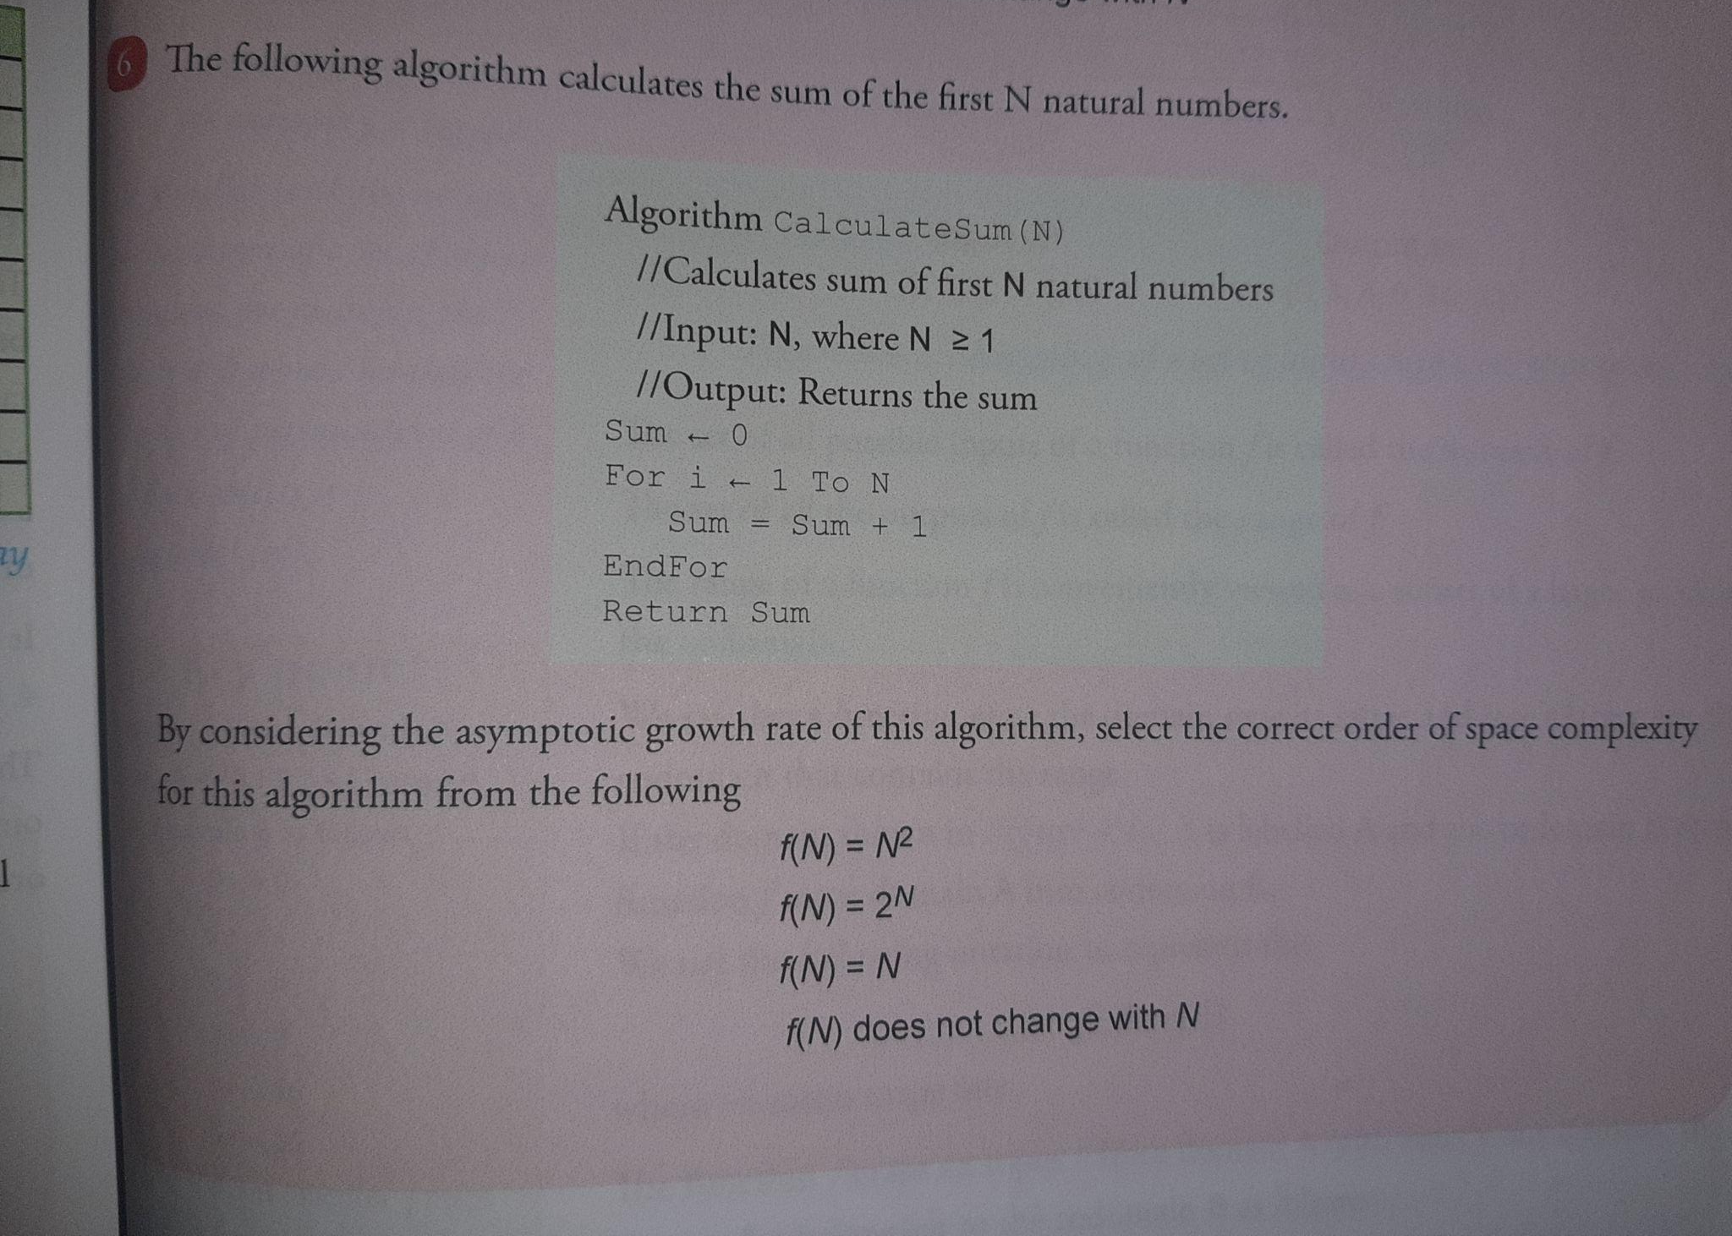
Questions

Slide 13
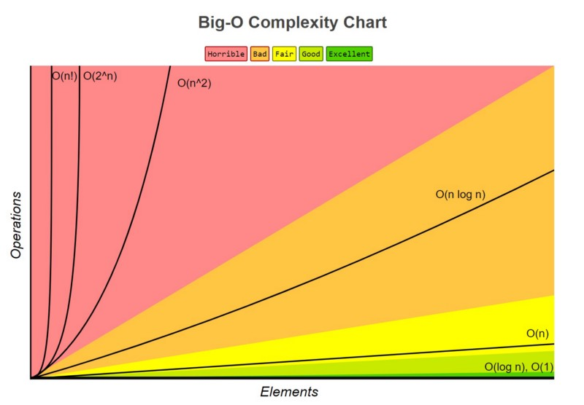
4.4.4.3 Order of complexity
Support
Derek Banas
Video 1

Slide 14
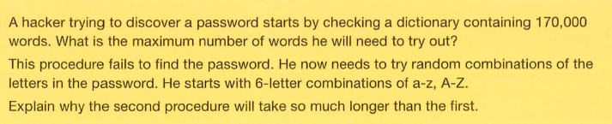
Questions
170000

Slide 15
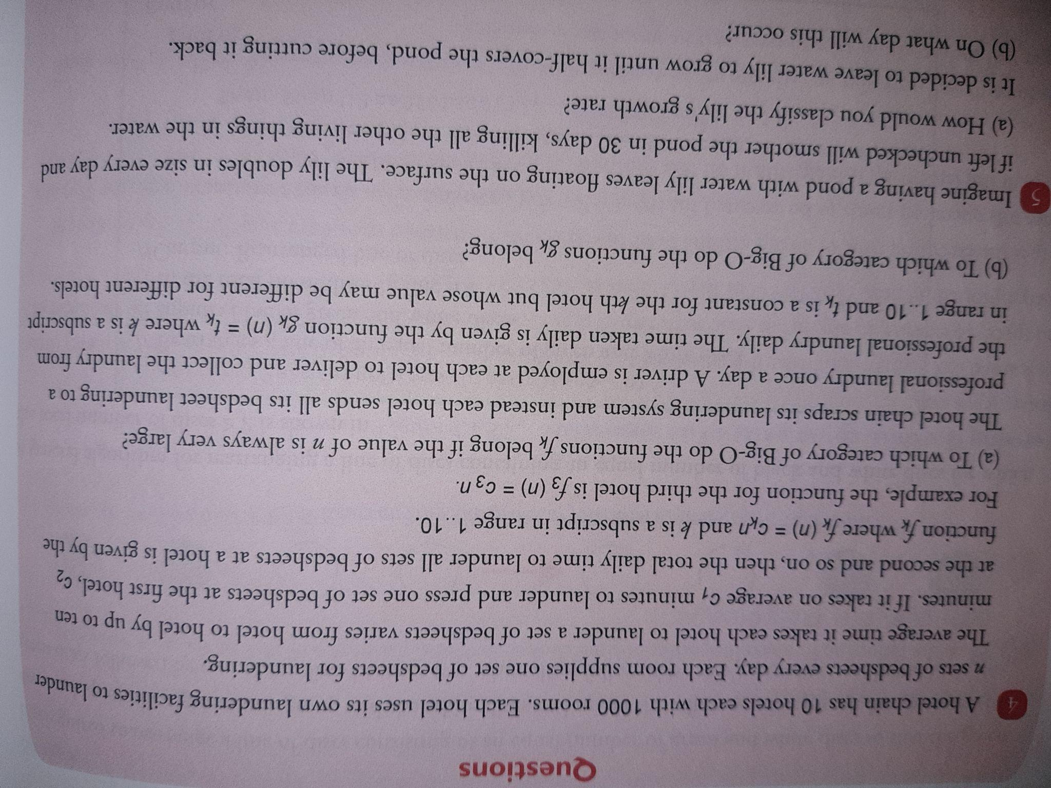
Questions
f_{k}(n) = c_{k}n
f_{k}(n) = n
B)
constant
Excellent

Slide 16
Questions
2^{n} //
Exponential - Horrible
29 //

Slide 17
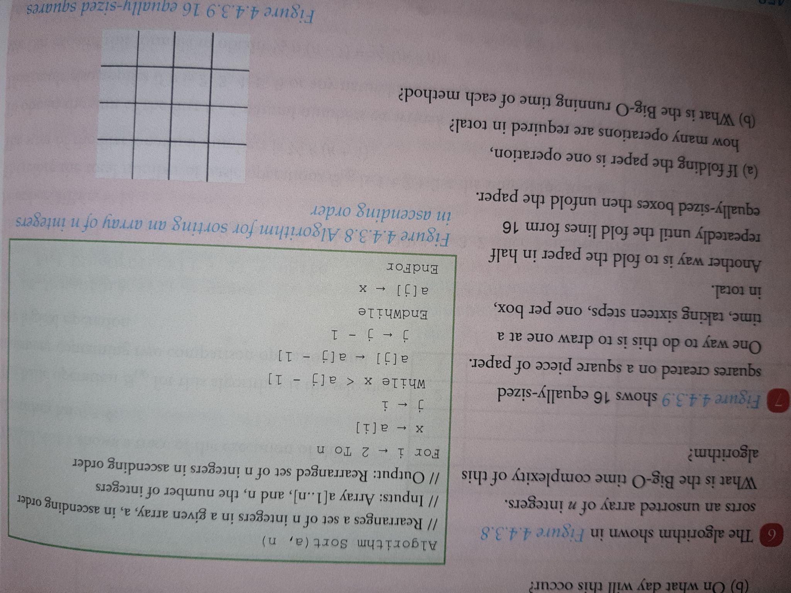
Questions
(N-2)*n
N^2
A)4 //
B)
O(n) - drawing
O(log(2n)) - folding

Slide 18
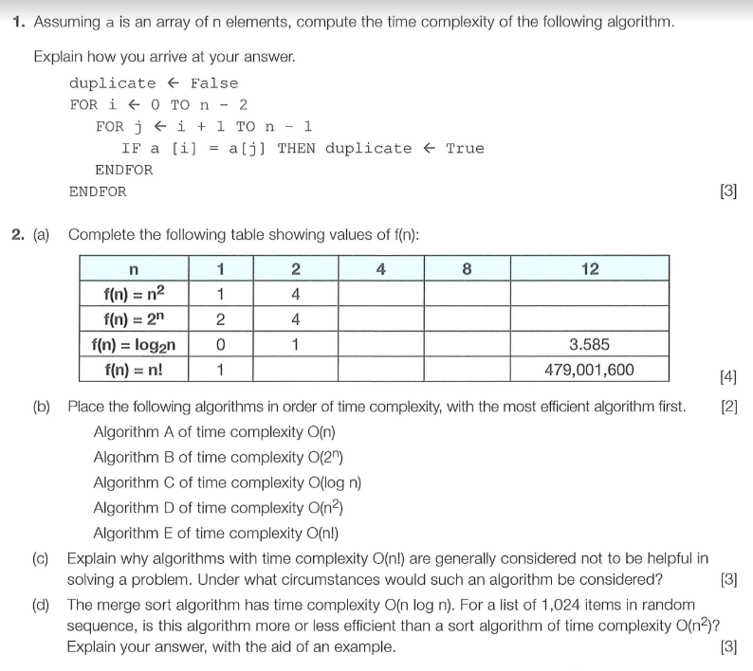
Exam style Questions
1)n^2
2)
n | 1 | 2 | 4 | 8 | 12
 | 1 | 4 | 16 | 64 | 144
 | 2 | 4 | 16 | 258 | 4096
 | 0 | 1 | 2 | 3 | 3585
 | 1 | 2 | 24 | 40320 | 579001600

Slide 19
Exam style Questions

Slide 20
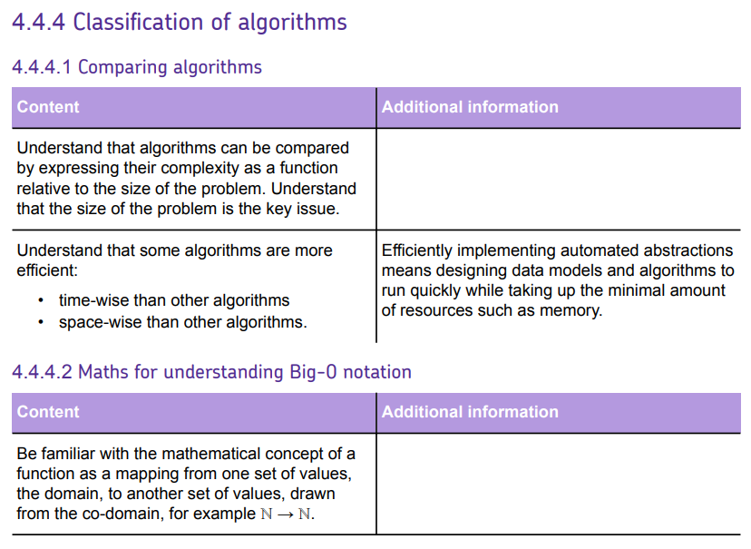
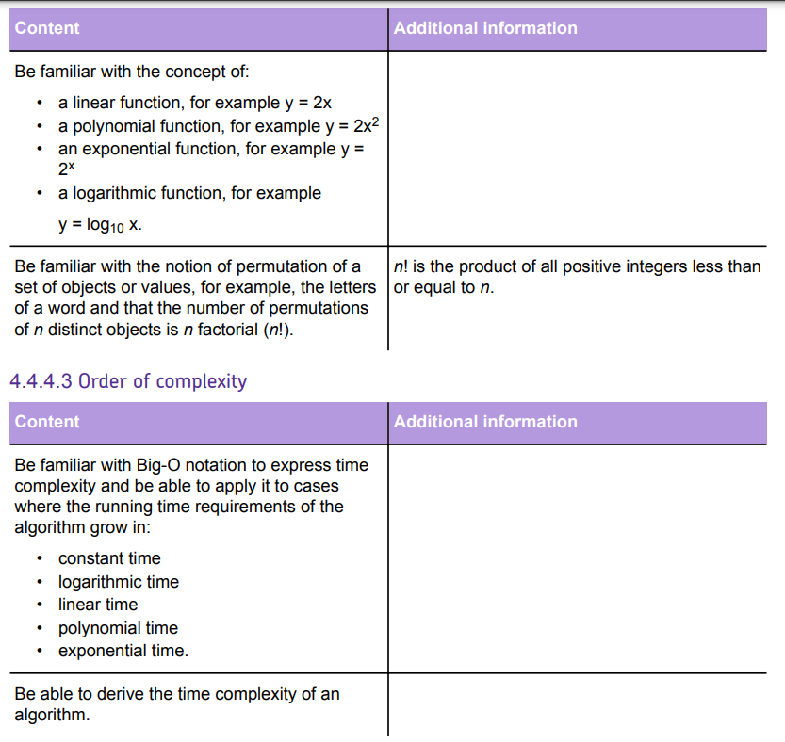

Slide 22
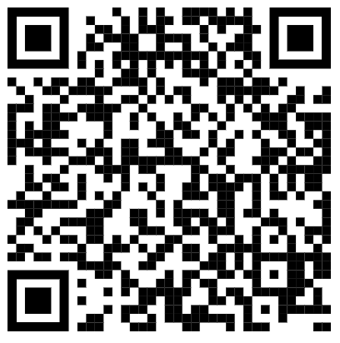
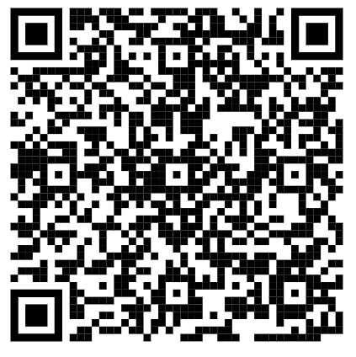
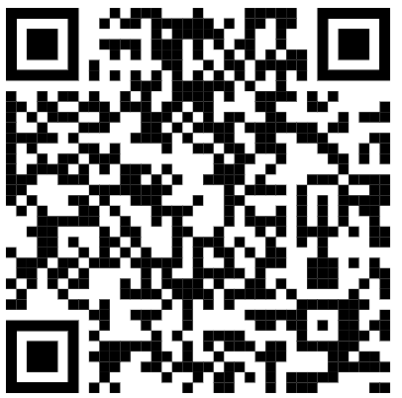
Useful links
Playlist 1 - Craig N Dave Classification Youtube playlist - videos 1 to 4
Website 1 - A level Computer Science Wikibook
Website 2 - Isaac Computer Science website - Sections 4.4.4.1 to 4.4.4.3
Playlist 1 | Website 1 | Website 2
Checklist
Objective | R | A | G
Understand that algorithms can be compared by expressing their complexity as a function relative to the size of the problem. Understand that the size of the problem is the key issue.
Understand that some algorithms are more efficient: • time-wise than other algorithms • space-wise than other algorithms.
Be familiar with the mathematical concept of a function as a mapping from one set of values, the domain, to another set of values, drawn from the co-domain, for example ℕ → ℕ.
Be familiar with the notion of permutation of a set of objects or values, for example, the letters of a word and that the number of permutations of n distinct objects is n factorial (n!).

Slide 23
Checklist
Objective | R | A | G
Be familiar with the concept of: • a linear function, for example y = 2x • a polynomial function, for example y = 2x2 • an exponential function, for example y = 2 x • a logarithmic function, for example y = log10 x.
Be familiar with Big-O notation to express time complexity and be able to apply it to cases where the running time requirements of the algorithm grow in: • constant time • logarithmic time • linear time • polynomial time • exponential time.
Be able to derive the time complexity of an algorithm.

